Slide 1



Fund in numbers*
Why GPMF?
Broader growth sources
  Access to companies prior to public listing and exposure to secular growth themes under‑represented in public markets.
Enhanced potential return & diversification
Returns driven by asset‑level fundamentals and contractual structures, reducing correlation and improving diversification.
Embedded inflation linkage
  Assets linked to real economic activity, with inflation pass‑through and downside protection.
2018
Launch of the abrdn Global Private Markets Fund.
£335m
Fund assets under management.
3,000+
Number of private assets accessed on a look-through basis.
*Source: Aberdeen Investments, as at 31 March 2026.
Global Private Markets Fund (GPMF)
Unlocking the potential in private markets
“
Our strategy has been designed as a one-stop solution for investors seeking to diversify their allocation beyond traditional assets.”
Nalaka De Silva
Head of Private Markets Solutions
This is a marketing communication. Please refer to the prospectus of the UCITS and to the KID / KIID before making any final investment decisions.
For Professional Investors Only – Not for public distribution. In Switzerland for Qualified Investors only.

Slide 2

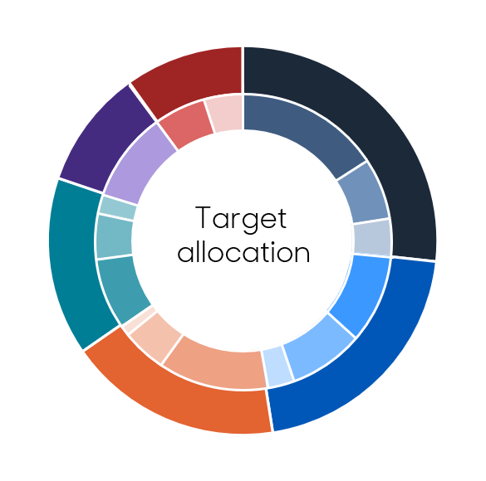

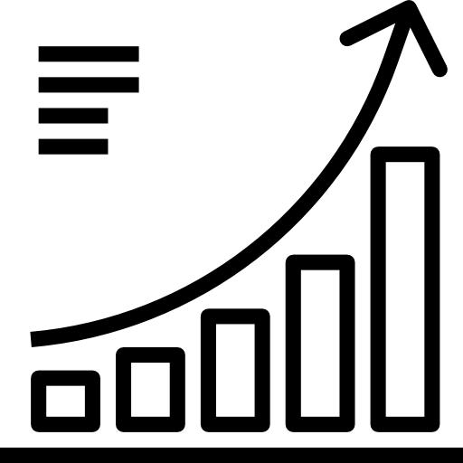




Access the benefits of a diversified, global private markets portfolio*
Liquid resources (10%)
Cash, money market instruments and exposure to liquid private market proxies
Private equity (27%)
Venture Capital to companies that require capital for growth, management buyouts and turnarounds
GPMF
Delivering a carefully constructed private markets portfolio to investors
Natural resources (10%)
Timber, agriculture, fisheries, aquaculture and physical commodities such as minerals
Private credit (15%)
Senior asset backed loans, subordinated debt, speciality finance and special situation funding
Infrastructure (21%)
Roads, schools, hospitals, transportation assets, energy generation
& supply and communication assets
Multi-Strategy
approach
Private Markets
focus
Evergreen
structure
Value-add real estate (18%)
The development of improvement of commercial buildings property, and mixed use and special purpose facilities
2018
Launch date
£335m
AuM
9.7%
Gross over 5yrs p.a.
Buyout
Economic
RE Value-Add
Special Situations
Liquid Privet Market Strategies
Growth
Concession
Opportunistic
Non-Investment Grade
Cash
Venture
Value Add Infra
Core Plus
Investment Grade
Natural Resources
Quarterly
dealing frequency
0
Lock up period
Flat & transparent
fee structure
A multi‑strategy approach that aims to strengthen portfolio outcomes
Powering
next-gen
innovation
Fuelling
economic
growth
Building
essential infrastructure
Source: Aberdeen, 31 March 2026. Data shown in GBP. Since inception: 15 January 2018. Performance is shown gross of fees, based on the GBP share class, and does not reflect investment management fees.
Past performance does not predict future returns.
High growth potential
AI • Space exploration • Data • Healthcare technology • Fintech
Growth & Income
Logistics • Services • Housing • Advanced manufacturing
Income & Inflation linkage
Transport • Digital infrastructure • Utilities • Energy transition
*Figures may not add to 100% due to rounding.

Slide 3
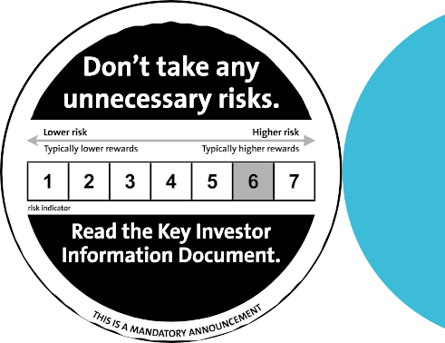
Important Information
For professional clients only – Not for public distribution.
Past performance is not a guide to future results. The value of investments, and the income from them, can go down as well as up and clients may get back less than the amount invested.
The fund is an umbrella fund with segregated liability between sub-funds incorporated as an Irish collective asset-management vehicle with registered number C46640 and authorised by Carne Global Fund Managers (Ireland) Limited. The ICAV is a qualifying investor alternative investment fund for the purposes of AIFMD and has appointed Carne Global Fund Managers (Ireland) to be its AIFM. Shares in the ICAV are offered only on the basis of the information contained in this Prospectus, the Supplement for the relevant Fund and, after publication, the ICAV’s latest audited annual accounts.
The information contained in this marketing document should not be considered as an offer, investment recommendation or solicitation, to deal in the shares of any securities or financial instruments. It is not intended for distribution or use by any person or entity who is a citizen or resident of or located in any jurisdiction where such distribution, publication or use would be prohibited. No information, opinions or data in this document constitute investment, legal, tax or other advice and are not to be relied upon in making an investment or other decision. The tax treatment depends on the individual circumstances of each client and may be subject to change in the future. Subscriptions for shares in the fund may only be made on the basis of the latest Prospectus which can be obtained free of charge upon request or from aberdeeninvestments.com.
Any data contained herein which is attributed to a third party ("Third Party Data") is the property of (a) third party supplier(s) (the “Owner”) and is licensed for use by Aberdeen Group plc. Third Party Data may not be copied or distributed. Third Party Data is provided “as is” and is not warranted to be accurate, complete or timely. To the extent permitted by applicable law, none of the Owner, Aberdeen Group plc or any other third party (including any third party involved in providing and/or compiling Third Party Data) shall have any liability for Third Party Data or for any use made of Third Party Data. Neither the Owner nor any other third party sponsors, endorses or promotes the fund or product to which Third Party Data relates.
Subscriptions for shares in the fund may only be made on the basis of the latest Prospectus which can be obtained free of charge upon request or from aberdeeninvestments.com.
United Kingdom (UK): Issued by abrdn Investments Limited which is registered in Scotland (SC108419) at 1 George Street, Edinburgh EH2 2LL and authorised and regulated by the Financial Conduct Authority in the UK.
Belgium, Denmark, Finland, France, Iceland, Ireland, Italy, Luxembourg, Netherlands, Norway, Spain, and Sweden: Produced by abrdn Investments Limited which is registered in Scotland (SC108419) at 1 George Street, Edinburgh EH2 2LL and authorised and regulated by the Financial Conduct Authority in the UK. Unless otherwise indicated, this content refers only to the market views, analysis and investment capabilities of the foregoing entity as at the date of publication. Issued by abrdn Investments Ireland Limited. Registered in Republic of Ireland (Company No.621721) at 2-4 Merrion Row, Dublin D02 WP23. Regulated by the Central Bank of Ireland. Aberdeen Investments Global is a business name of abrdn Investments Ireland Limited.
Austria, Germany: Issued by abrdn Investments Limited which is registered in Scotland (SC108419) at 1 George Street, Edinburgh EH2 2LL and authorised and regulated by the Financial Conduct Authority in the UK.
Switzerland: Issued by abrdn Investments Switzerland AG. Registered in Switzerland (CHE-114.943.983) at Schweizergasse 14, 8001 Zürich. Aberdeen Investments Global is a business name of the foregoing entity.
Singapore: abrdn Asia Limited, Registration Number 199105448E.
The Portfolio Manager and Distributor is abrdn Investment Management Limited (SC123321), registered in Scotland at 1 George Street, Edinburgh, EH2 2LL and authorised and regulated in the UK by the Financial Conduct Authority.
The AIFM is Carne Global Fund Managers (Ireland) Limited, registered in the Republic of Ireland (Company no. 377914) at 3rd Floor, 55 Charlemont Place, Dublin 2 and regulated by the Central Bank of Ireland.
For more information visit aberdeeninvestments.com.
Investment Objective: The fund aims to generate growth over the long term by investing in a diversified portfolio of private market assets. Investors should be aware that
there are risks inherent in all investments and there can be no guarantee against loss resulting from investments in the Fund.
Fund-specific risks:
Liquidity Risk
Private market assets are inherently illiquid. Selling private market assets can be a lengthy process, and the price at which assets can be sold may be uncertain. Consequently, investors in the relevant Fund should be aware that they may not be able to sell their investment when they want to, and the Fund’s performance may be adversely affected by the sale of assets to meet redemption demands.
Redemption requests may from time to time be satisfied by the sale of more liquid assets which could adversely affect the liquidity profile of a Fund to the detriment of remaining investors.
Suspension Risk
In exceptional circumstance, the Directors of the Fund with the approval of the Depositary may temporarily suspend the issue, valuation, sale, purchase, redemption
or conversion of shares in the Fund.
Private Markets Risk
Private market assets have certain characteristics which have associated risks. Because assets do not trade on public markets, valuation and pricing may be difficult to determine. Assets may be long-term projects which have development risk and uncertainty regarding their financial viability and overall the risk of default, bankruptcy or dilution of the value of a Fund’s holding in individual assets is higher than for public market assets.
STA0225588692-001

